Slide 1


COMPUTER NETWORKS
24CS2202
Topic:
Guided and unguided media
Session - 8

Slide 2



AIM OF THE SESSION
To familiarize students with different transmission media in Computer networks.
INSTRUCTIONAL OBJECTIVES
This Session is designed to:
Describe different guided transmission media.
Describe different unguided transmission media.
LEARNING OUTCOMES
At the end of this session, you should be able to:
Describe guided and unguided transmission media.
Understand the characteristics of twisted, untwisted, coaxial cable and fiber optic cables.
Understand characteristics of radio, microwave and infrared waves and explain how they transmit data.

Slide 3
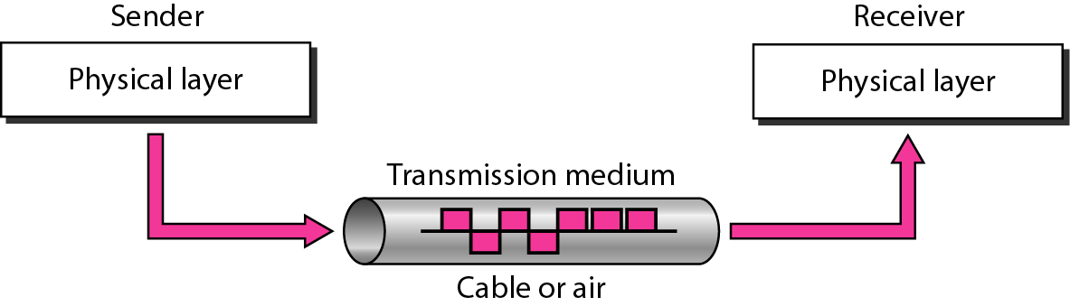
TRANSMISSION MEDIA
Transmission media are located below the physical layer and are directly controlled by the physical layer.
Its main functionality is to carry information from the sender to the receiver in the form of bits (Either as Electrical signals or Light pulses).

Slide 4
TRANSMISSION MEDIA
Factors for designing the Transmission Media:
Bandwidth: Greater the bandwidth of a medium, higher the data transmission rate of a signal.
Transmission impairment: The quality of the signals will get destroyed due to transmission impairment which means that the received signal is not identical to the transmitted one.
Interference: The process of disrupting a signal when it travels over a communication medium due to the addition of some unwanted signal.

Slide 5
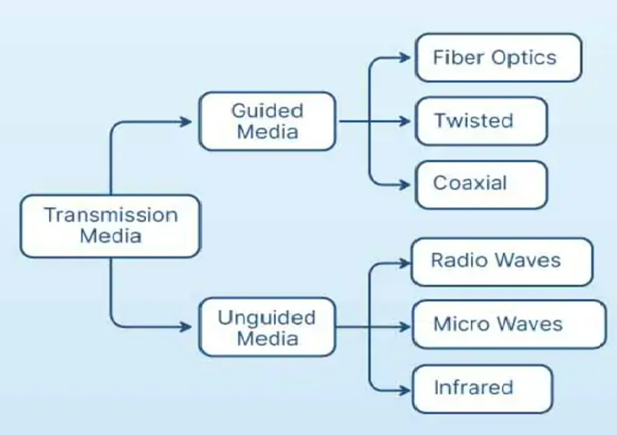
CLASSIFICATION OF TRANSMISSION MEDIA

Slide 6
GUIDED MEDIA

Slide 7
GUIDED MEDIA
Guided Media is defined as the physical medium through which the signals are transmitted.
It is also known as Bounded media.
Types Of Guided media:
    Twisted pair
    Coaxial Cable
    Fiber-Optic Cable

Slide 8

GUIDED MEDIA : Twisted Pair
Twisted Pair:
Twisted pair is a physical media made up of a pair of cables twisted with each other.
Cheap as compared to other transmission media.
Installation is easy, and it is a lightweight cable.
The frequency range for twisted pair cable is from 0 to 3.5KHz.
A twisted pair consists of two insulated copper wires arranged in a regular spiral pattern.
Increasing the number of turns per foot decreases noise interference.

Slide 9
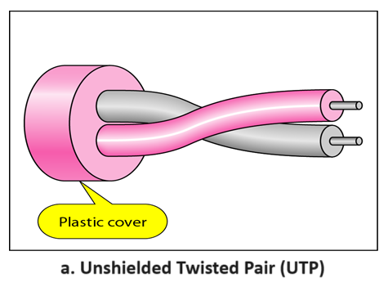
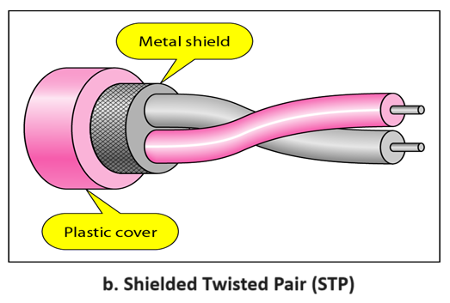
GUIDED MEDIA : Twisted Pair
Types of Twisted Pairs:
Unshielded Twisted Pair: An unshielded twisted pair is widely used in telecommunication.
Shielded Twisted Pair: A shielded twisted pair is a cable that contains the mesh surrounding the wire that allows the higher transmission rate.

Slide 10
GUIDED MEDIA : Twisted Pair
UTP | STP
Advantages | Advantages
It is cheap. Installation of the unshielded twisted pair is easy. It can be used for high-speed LAN. | An installation of STP is easy. It has higher capacity as compared to unshielded twisted pair cable. It has a higher attenuation. It is shielded that provides the higher data transmission rate.
Disadvantages | Disadvantages
This cable can only be used for shorter distances because of attenuation. | It is more expensive as compared to UTP and coaxial cable. It has a higher attenuation rate.

Slide 11
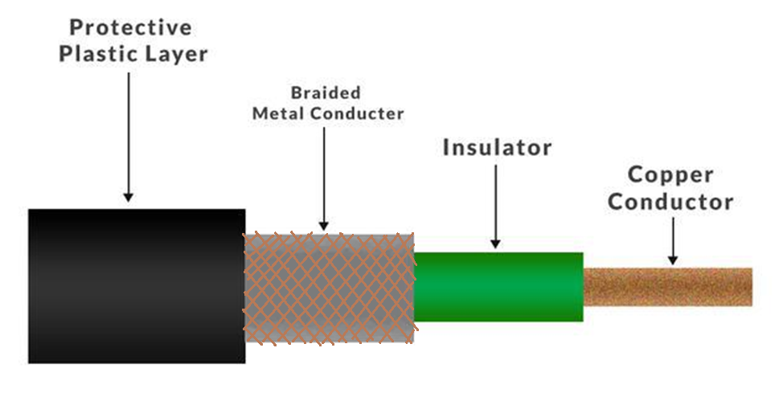
GUIDED MEDIA : Coaxial Cable
Coaxial Cable:
Coaxial cable is very commonly used transmission media, for example, TV wire is usually a coaxial cable.
It has a higher frequency as compared to Twisted pair cable.
It contains two conductors parallel to each other.
The inner conductor of the coaxial cable is made up of copper, and the outer conductor is made up of copper mesh.
The middle core is made up of non-conductive cover that separates the inner conductor from the outer conductor.
The middle core is responsible for the data transferring whereas the copper mesh prevents from the EMI (Electromagnetic interference).

Slide 12
GUIDED MEDIA : Coaxial Cable
Coaxial Cable Types:
Baseband transmission: It is defined as the process of transmitting a single signal at high speed.
Broadband transmission: It is defined as the process of transmitting multiple signals simultaneously.
Advantages of Coaxial Cable | Disadvantages of Coaxial Cable
The data can be transmitted at high speed. It has better shielding as compared to twisted pair cable. It provides higher bandwidth. | It is more expensive as compared to twisted pair cable. If any fault occurs in the cable causes the failure in the entire network.

Slide 13
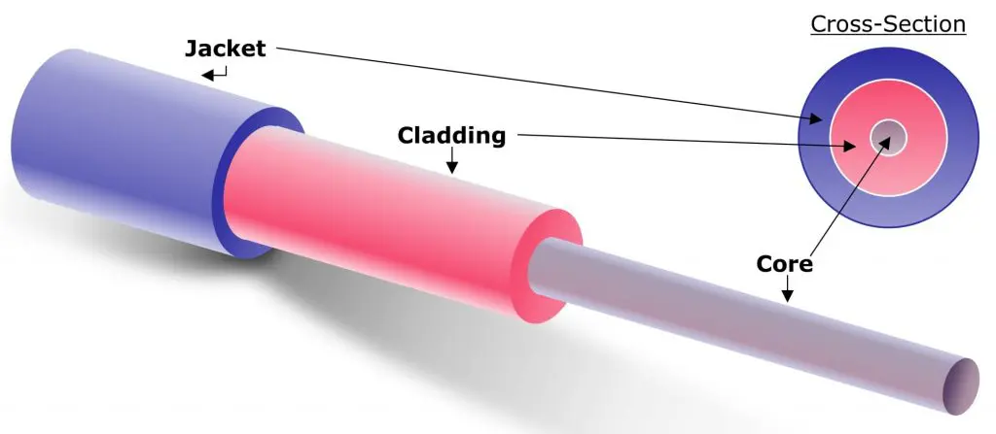
GUIDED MEDIA : Fibre Optic Cable
Fibre Optic:
Fibre optic cable uses electrical signals for communication.
It holds the optical fibres coated in plastic that are used to send the data by pulses of light.
The plastic coating protects the optical fibres from heat, cold, electromagnetic interference from other types of wiring.
Fibre optics provide faster data transmission than copper wires.
Core: Strand of glass or plastic through which the light waves are transmitted. The more the area of the core, the more light will be transmitted into the fibre.
Cladding: The concentric layer of glass that is used to cause the reflection within the core so that the light waves are transmitted through the fibre.
Jacket: The protective coating that is used to preserve the fibre strength, absorb shock and extra fibre protection.

Slide 14
GUIDED MEDIA : Fibre Optic Cable
Advantages of Fibre Optic:
Greater Bandwidth: Fibre optic cable provides more bandwidth and therefore it carries more data as compared to copper cable.
Faster speed: Fibre optic cable carries the data in the form of light and thus it carries the signals at a higher speed.
Longer distances: Fibre optic cable carries the data at a longer distance as compared to copper cable.
Better reliability: Fibre optic cable is more reliable than the copper cable as it is immune to any temperature changes.
Thinner and Sturdier: Fibre optic cable is thinner and lighter in weight.

Slide 15
UNGUIDED MEDIA

Slide 16
UNGUIDED MEDIA
An unguided transmission transmits the electromagnetic waves without using any physical medium.
Also known as wireless transmission.
In unguided media, air is the media through which the electromagnetic energy can flow easily.
Types of Unguided Media:
    Radio Waves
    Micro Waves
    Infrared Waves

Slide 17
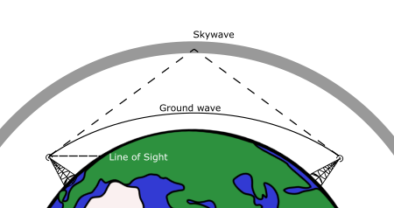
UNGUIDED MEDIA : Radio Waves
Radio Waves:
Radio waves are the electromagnetic waves that are transmitted in all the directions of free space.
Radio waves are omnidirectional, i.e., the signals are propagated in all the directions.
The range in frequencies of radio waves is from 3Khz to 1Ghz.
The sending and receiving antenna are not aligned, i.e., the wave sent by the sending antenna can be received by any receiving antenna.
An example of the radio wave is FM radio.

Slide 18
UNGUIDED MEDIA : Radio Waves
Applications Of Radio waves:
A Radio wave is useful for multicasting when there is one sender and many receivers.
Examples of Radio Waves: FM radio, Television, Cordless phones.
Advantages Of Radio transmission:
Radio transmission is mainly used for wide area networks and mobile cellular phones.
Radio waves cover a large area.
Radio transmission provides a higher transmission rate.

Slide 19
UNGUIDED MEDIA : Micro Waves
Micro Waves:
Electromagnetic waves having frequencies between 1 and 300 GHz are called microwaves.
Microwaves are unidirectional. The sending and receiving antennas need to be aligned.
A pair of antennas can be aligned without interfering with another pair of aligned antennas.
Types of Microwaves:
Terrestrial Microwave: Microwaves that transmits the beam of a radio signal from one ground-based antenna to another ground-based antenna.
Satellite Microwave: Microwaves that transmits data (in form of radio signals) between a ground-based station and an orbiting satellite.

Slide 20
UNGUIDED MEDIA : Infrared Waves
Infrared Waves:
An infrared transmission is a wireless technology used for communication over short ranges.
The frequency range of the infrared is 300 GHz to 400 THz.
It is used for short-range communication such as data transfer between two cell phones, TV remote operation, data transfer between a computer and cell phone resides in the same closed area.
Characteristics Of Infrared:
It supports high bandwidth, and hence the data rate will be very high.
Infrared waves cannot penetrate the walls. Therefore, the infrared communication in one room cannot be interrupted by the nearby rooms.
An infrared communication provides better security with minimum interference.

Slide 21
SELF-ASSESSMENT QUESTIONS
Which of this is not a guided media?
Fiber Optic Cable
Coaxial Cable
Wireless LAN
Twisted Pair
Coaxial cable consists of _______ concentric copper conductors.
1
2
3
4
3. _____ cable can carry signals of higher frequency ranges than _____ cable.
Twisted pair; Fiber Optic
Twisted pair; Fiber Optic
Fiber Optic; Coaxial Cable
None

Slide 22
SELF-ASSESSMENT QUESTIONS
Which of this is not a guided media?
Fiber Optic Cable
Coaxial Cable
Wireless LAN
Twisted Pair
Coaxial cable consists of _______ concentric copper conductors.
1
2
3
4
3. _____ cable can carry signals of higher frequency ranges than _____ cable.
Twisted pair; Fiber Optic
Twisted pair; Fiber Optic
Fiber Optic; Coaxial Cable
None

Slide 23

Topic Summary
Transmission Media
  Guided Media
        Twisted pair
        Coaxial Cable
        Fiber-Optic Cable
  Unguided Media
          Radio Waves
          Micro Waves
          Infrared Waves

Slide 24
REFERENCES FOR FURTHER LEARNING OF THE SESSION
Reference Books:
A.S. Tanenbaum, David J. Wetheral “Computer Networks” Pearson, 5th Edition.
Kurose, J and Ross, K Computer Networking: A Top-Down Approach Addison-Wesley- 6th edition.
Sites and Web links:
https://www.geeksforgeeks.org/types-of-transmission-technology/
https://www.tutorialspoint.com/data_communication_computer_network/computer_network_topologies.htm
3. https://www.javatpoint.com/computer-network-transmission-modes

Slide 25
THANK YOU
Team – Computer Networks

